Slide 1
A introduction to ROS and GIT
From UR10 perspective

Slide 2
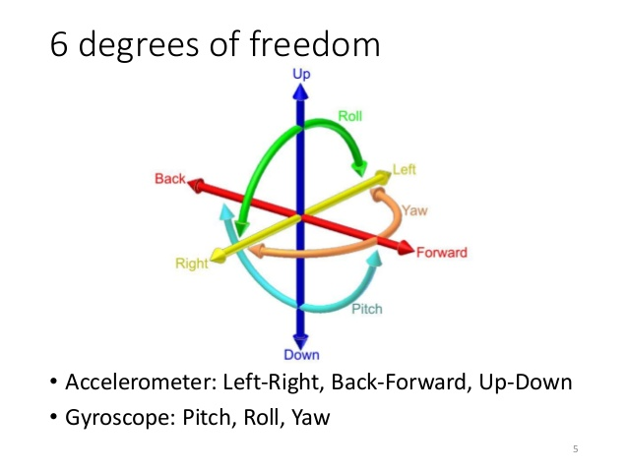
A quick review of Kinematics
Cartesian coordinate system.
A position is represented by a tuple of coordinates. E.g. (x, y, z)
A orientation is represented by a tuple of degrees. E.g. (Pitch, Roll, Yaw)

Slide 3
Combine the position and orientation, we get a new tuple of numbers, called Pose.
In ROS, a Pose is defined in message geometry_msgs/Pose, which contains two elements: geometry/Point position and geometry/Quaternion orientation.

Slide 4
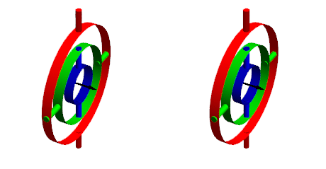
Why Quaternion ?
Because of “Gimbal Lock”.
Because better interpolation technique called Spherical LERP.

Slide 5
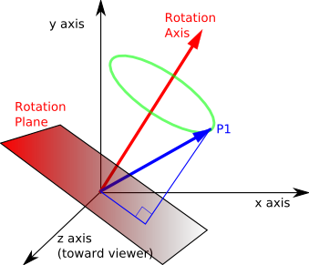
In ROS Quaternion is defined as
Float x, Float y, Float z, Float w, where x, y, z represents the rotation axis and w represent the radian of rotation.

Slide 6
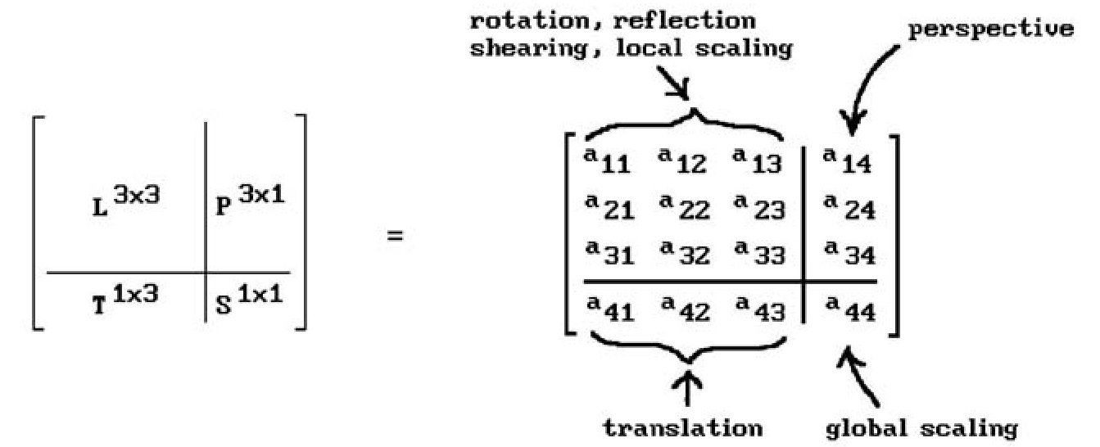
Reference frame
The coordinate system in which a coordinate is defined.
A transformation from one frame to another equals to the transformation from the origin to the new origin of another frame in the old frame.
Homogenous transformation matrix
The matrix representation of the transformation between Pose in the system.
The actual ROS transformation is done in Quaternion and converted back to Cartesian for reasons mentioned before.

Slide 7
Kinematics
Forward Kinematics
Robot often has many moving joints and the technique to find the pose of given part of robot in certain reference frame knowing the joint status is called Forward Kinematics.
Inverse Kinematics
The technique to find the joint status knowing the pose of certain part of robot.
This is the most common technique used in robotic kinematics.
The end effector is the most common robot part of interest.
There could be more than 1 solutions or no solution for given pose.
The job usually includes SLERP between the current Pose and destination Pose. Then calculate IK for all Pose in the trajectory.

Slide 8
Meet ROS
ROS is a peer-to-peer robot middleware Package.
In ROS, all major functionality is broken up into a number of chunks that communicate with each other using messages.
Each chunk is called a node and is typically run as a separate process.
Matchmaking between nodes is done by the ROS Master

Slide 9
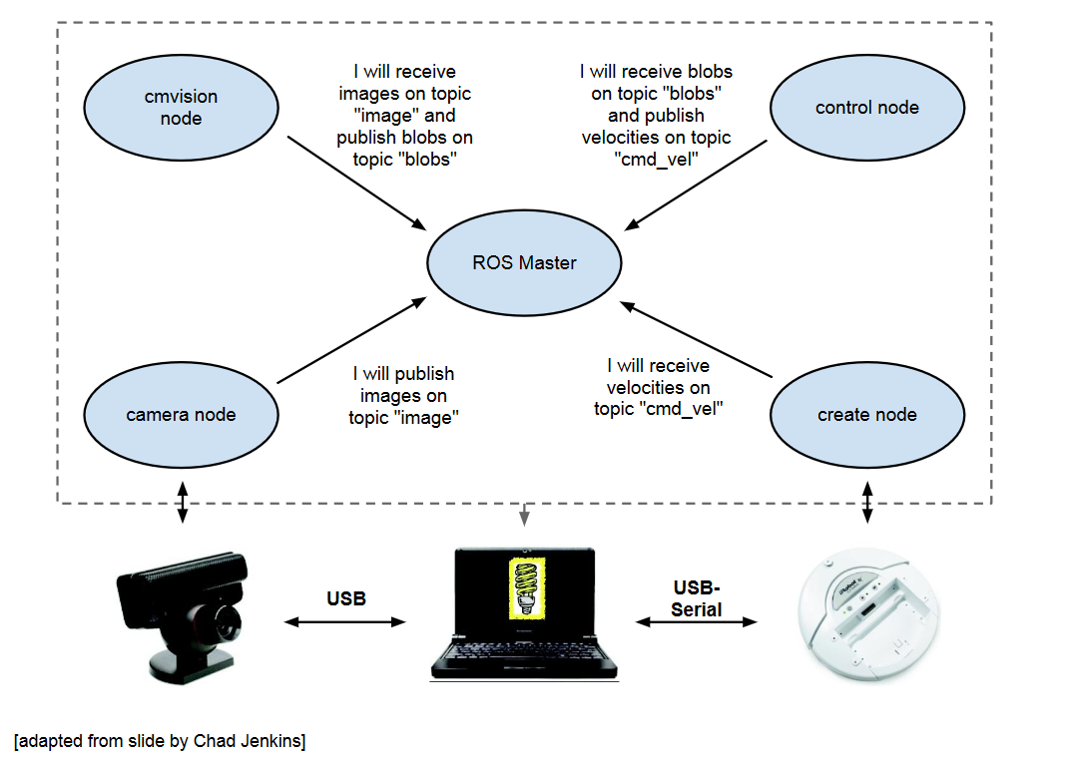
How ROS works
The registering stage

Slide 10

How ROS works
The working stage

Slide 11
ROS nodes
A node is a process that performs some computation.
Typically we try to divide the entire software functionality into different modules - each one is run over a single or multiple nodes.
Nodes are combined together into a graph and communicate with one another using streaming topics, RPC services, and the Parameter Server
These nodes are meant to operate at a fine-grained scale; a robot control system will usually comprise many nodes

Slide 12
ROS Topics
Topics are named virtual buses over which nodes exchange messages
Topics have anonymous publish/subscribe semantics - A node does not care which node published the data it receives or which one subscribes to the data it publishes ( what is the implication ? )
There can be multiple publishers and subscribers to a topic
Each topic is strongly typed by the ROS message it transports
Transport is done using TCP or UDP

Slide 13
ROS Message
Nodes communicate with each other by publishing and subscribe to topics in the form of particular type of message.
A message is a simple data structure, comprising typed fields.
.msg files are simple text files for specifying the data structure of a message. These files are stored in the msg subdirectory of a package.
The convention of message namig is: package name + / +.msg file.
For example, std_msgs/msg/String.msg has the message type std_msgs/String.

Slide 14
Example of .msg file
#data fields in sequential storage.
int8 FOO=1
uint16 BAR
float FooBar

Slide 15
ROS Service
The implementations of a publish/subscribe model allows one-many own way communication.
When two way communication is needed, ROS applies request/reply model. It’s implemented as ROS service.
A providing ROS node offers a service under a string name, and a client calls the service by sending the request message and awaiting the reply.
ROS service is the equivalent to common RPC model and works in a blocking way.
ROS service is defined in .srv file in package/srv/ directory.

Slide 16
.srv file example
A .srv file contains data fields with optional default value.
The request part and response part are separated by ‘---’
#request constants
int8 FOO=1
int8 BAR=2
#request fields
int8 foobar
another_pkg/AnotherMessage msg
---
#response constants
uint32 SECRET=123456
#response fields
another_pkg/YetAnotherMessage val
uint32 an_integer

Slide 17
ROS action server
Action server is an asynchronous server, which works in a non-blocking way. Calling to the action client proxy returns immiedately.
The client send request by issue sendGoal().
The client request feedback from the action server at any time in non-blocking way.
The client callback is invoked when the execution in server is done.

Slide 18
ROS Command line tools
ROS command line tools are a set of commands manipulates the ROS system.
These commands need to be run in a specific ROS shell, usually RosBash. Using “source /opt/ros/lunar/setup.bash” to start the shell in any terminal.
Certain robot may come with special shell or shell setup script. Check with your provider.

Slide 19
Important ROS commands
roscd change directories using a package name.
roscd <package-or-stack>[/subdir]
rosls list the contents of a package, stack, or location.
rosrun run an executable in an arbitrary package from anywhere without having to give its full path rosrun <package> <executable>
roslaunch launches a set of nodes from an XML configuration file, that is called launch script. They can be found in pkg/launch directory.

Slide 20
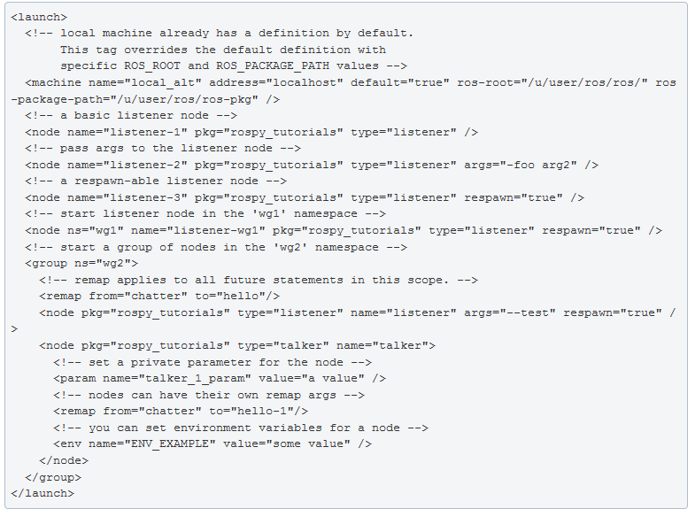
Example of launch script

Slide 21
Important command conti.
rostopic displays run-time information about topics and also lets you print out messages being sent to a topic.
rossrv displays Service srv data structure definitions.
rosservice displays run-time information about Services and also lets you print out messages being sent to a topic. It can also call the service with arguments.
rosnode displays runtime node information and lets you ping nodes to check connectivity.

Slide 22
Practices
Writing a Simple Publisher and Subscriber
http://wiki.ros.org/rospy_tutorials/Tutorials/WritingPublisherSubscriber
Turtlesim -- Moving in a Straight Line
http://wiki.ros.org/turtlesim/Tutorials/Moving%20in%20a%20Straight%20Line

Slide 23
Questions
Don’t be shy

Slide 24
GIT
Git is a version control system for tracking changes in computer files and coordinating work on those files among multiple people. It is primarily used for source code management in software development.
GitHub is a Web-based Git version control repository hosting service. In addition, it provides web hosting, issue tracking, project management and wiki page hosting.

Slide 25
Our web, repo and wiki page
Lab Web page:
https://ucroboticslab.github.io/
Lab repository https://github.com/UCRoboticsLab

